Slide 1

Outland Adventures
Angela, Jacob, Skyler, Cameron, William
Charlie Group

Slide 2
Outland Adventures Case Study
Blythe Timmerson and Jim Ford have opened a type of traveling agency called Outland Adventures.
Providing gear, locations, and information, they will be allowing those who enjoy the outdoors to experience new places and adventures. They currently have 7 employees, including themselves.
They are looking to optimize their organization by tracking equipment sales, keeping up to date on popular locations, and inventory status.

Slide 3
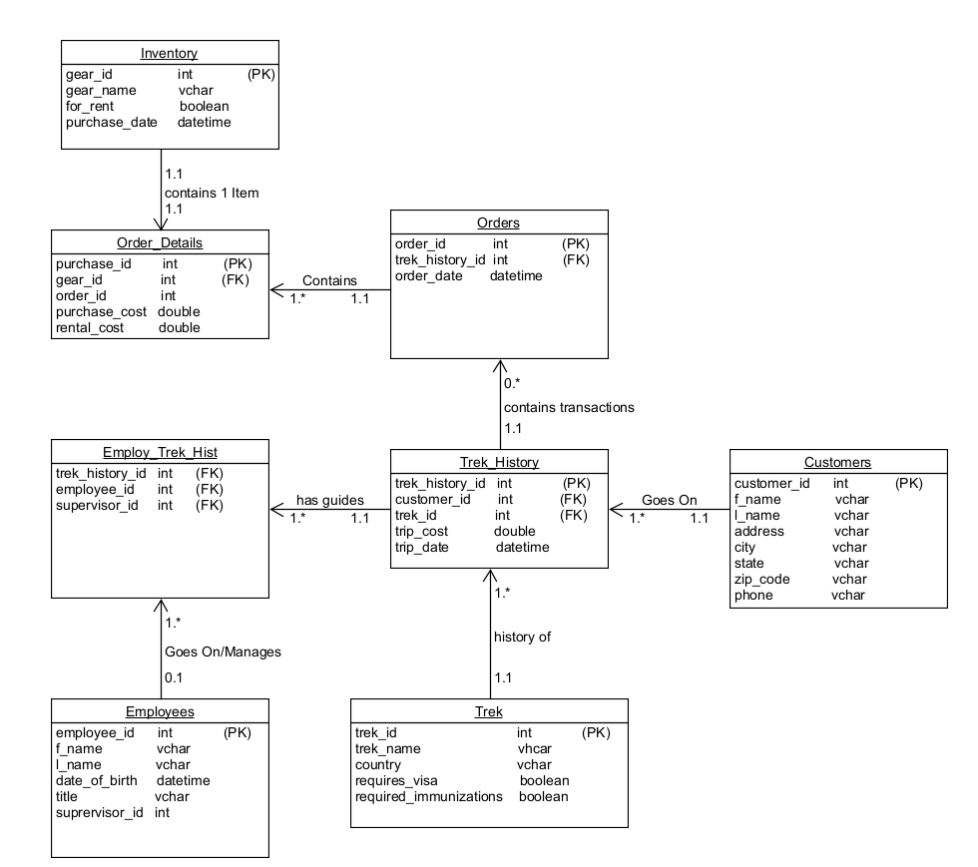
ORD

Slide 4
Assumptions
A customer must have trek booked to rent or purchase gear
A customer can go on multiple treks
Multiple customers can go on a single trek
A trek will always have at least one guide
Not all employees have been on, or will supervise a trek
Not all customers will purchase gear, own gear is permitted

Slide 5
Business Rules
Every Customer goes on one to many treks, creating record in Trek_History
Every Trek_History record has one to many guides, recorded in Employ_Trek_Hist
Every Trek_History contains zero to many Orders transactions
Each Order Detail contains one item from Inventory
Every Trek will have a history of one or many Trek_History records, number depends on the number of customers booking and the Trek and the Date of the Trek
Every Order contains one to many Order_Details depending on the number of items ordered.
Not every Employee will go on or manage treks, recorded in Employ_Trek_Hist; An employee can go on zero or many

Slide 6
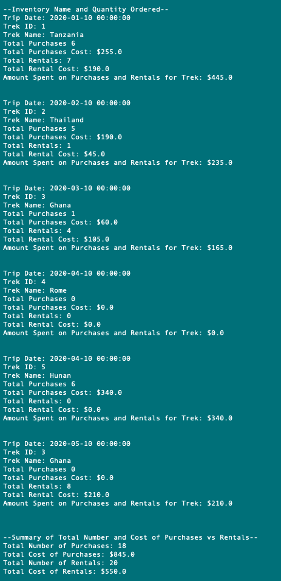

Purchases vs Rentals Per Trip Summary
Knowing whether customers are purchasing enough equipment or not is necessary information to keep your business running optimally. That’s why we created a report showing the sales and rentals of equipment as well as the overall summary of the two.

Slide 7
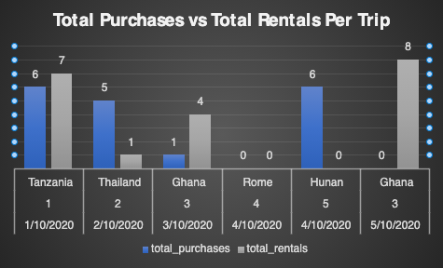
Purchases vs Rentals Per Trip Summary

Slide 8
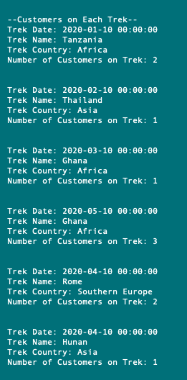
Customers Per Trek
In order to actively attract travelers and hikers, Outland Adventures will need to know which Treks are popular and which are falling off. By creating a report that shows this information will allow them to view customer trends, allowing adjustments as needed.

Slide 9
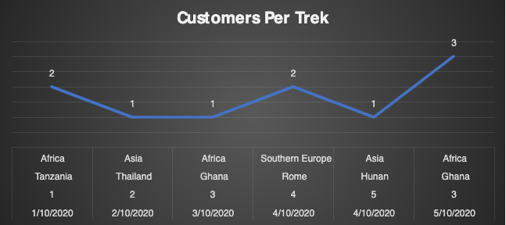
Customers Per Trek

Slide 10
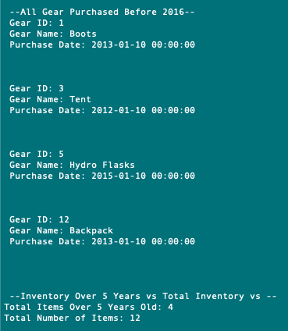
Gear over five years
Faulty equipment is always a liability, so having older gear can be concerning. This report will allow Outland Adventures to find the age of their gear, and buy accordingly.

Slide 11
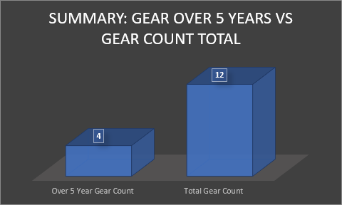
Gear over five years

Slide 12
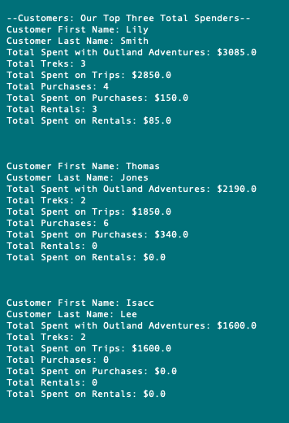
Top Spenders
Every business wants to reward its best customers, and the only way to do that is by knowing exactly who they are. With this report, Outland Adventures will be able to find the top 3 spenders, and will be able to react accordingly.

